Slide 1
What is a Commodity?
Physical market + Financial Market

Slide 2
Key Commodity Components
Homogenous Asset
Large numbers of Buyers and Sellers
Must be Buyable/Sellable into the future
Forward Curve Behavior
Contango
Backwardation

Slide 3
Global Futures and Options Volumes by Category
Jan – June 2008
Source: Futures Industry Association
Notes:
June 28 2010

Slide 4
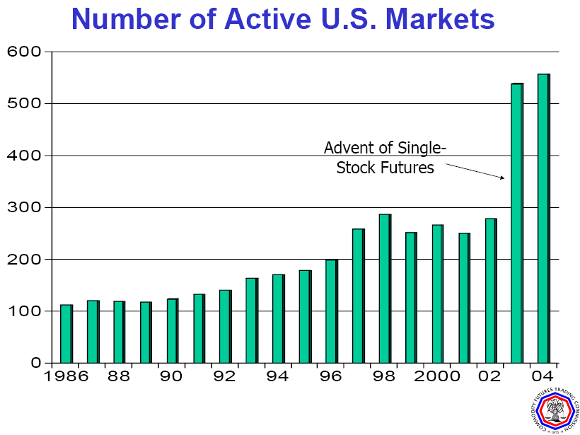

Slide 5
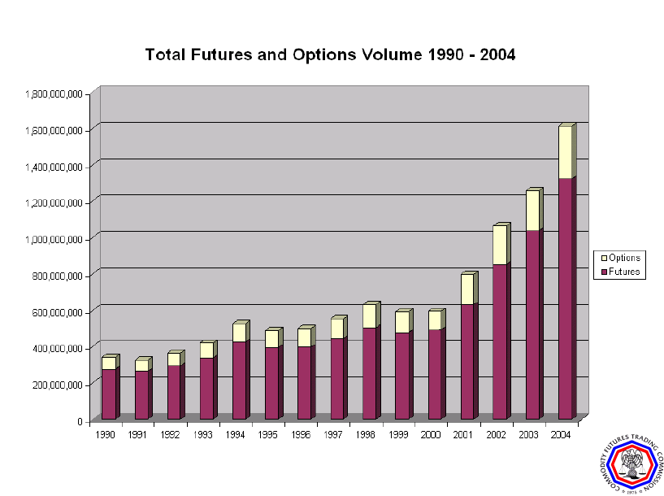

Slide 6
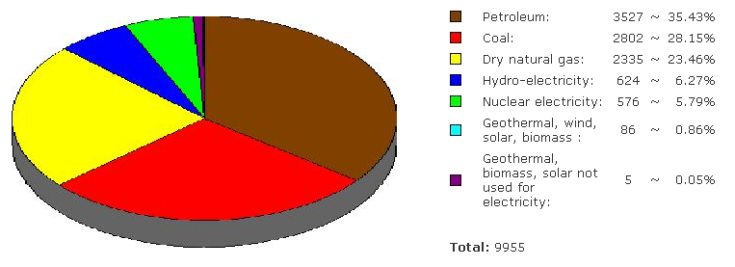
World Energy Consumption (2006)
Notes:
Updated Aug 16
WTI sets the price of crude oils around the world and therefore sets the price of energy around the world.
US demand closely mirrors world demand by type of energy
Note that transportation is the biggest user of oil –
Gasoline and diesel for cars
Jet fuel for airplanes

Slide 7
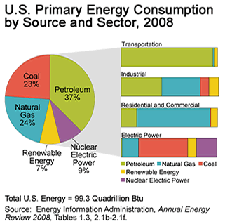
US Energy Consumption
Notes:
Updated 7 12 2010
WTI sets the price of crude oils around the world and therefore sets the price of energy around the world.
US demand closely mirrors world demand by type of energy
Note that transportation is the biggest user of oil –
Gasoline and diesel for cars
Jet fuel for airplanes

Slide 8
Units of Measurement
Price per Barrel (42 Gallons) or Cents per Gallon
Priced in U.S. dollars
Priced at Three Primary Locations
Cushing, Oklahoma - WTI
North Sea - Brent
Singapore - Dubai
Consumption in Millions of Barrels per Day (MMBbl/d)
Most energy converted to Barrels of Oil Equivalent (BOE)

Slide 9
Fundamental Drivers
Supply
OECD Crude and Product Inventories
Finding and Lifting Costs by Region
New Production - OPEC / Non-OPEC
Demand
World Economic Growth
World Population Growth
Inter-fuel Competition

Slide 10
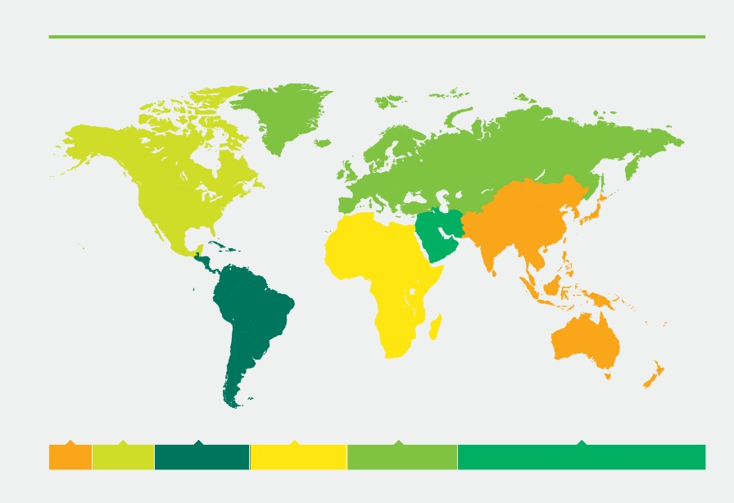
Proved oil reserves at end 2008
Thousand million barrels
Asia Pacific 42.0
North America 70.9
S. & Central America 123.2
Africa 125.6
Europe and Eurasia 142.2
Middle East 754.1
Notes:
Updated June 23 2010

Slide 11

Distribution of proved oil reserves 2008
North America
Asia Pacific
5.6
3.3
S. & Central America
59.9
Middle East
9.8
Africa
10
*2008
Total 1258.0 thousand million
barrels
11.3
Europe & Eurasia
Notes:
Updated June 23 2010

Slide 12
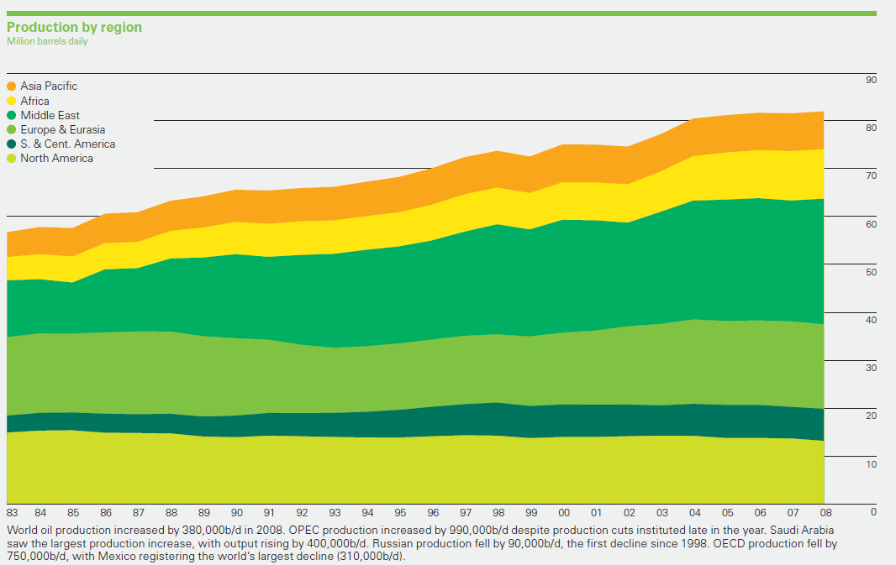
Oil production by area
Notes:
Updated June 27 2010

Slide 13
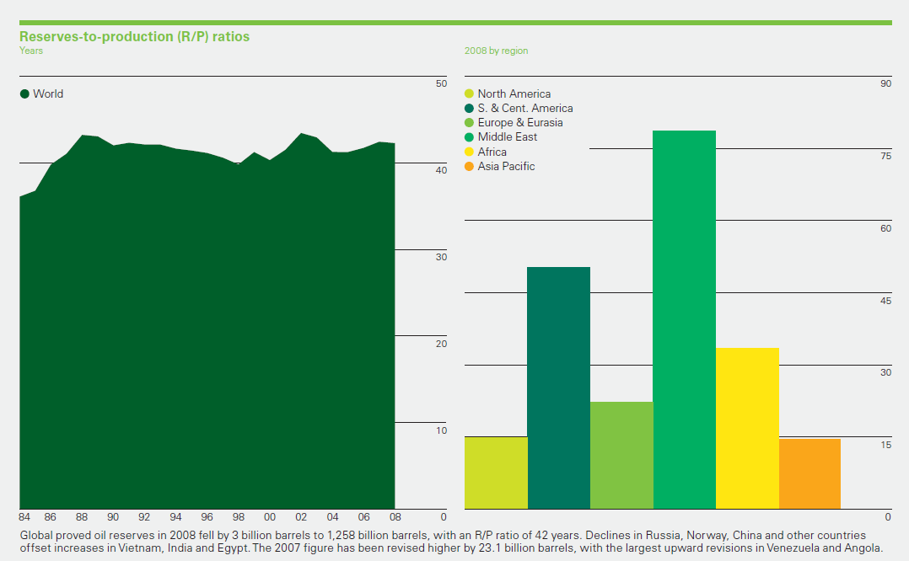
Oil reserves-to-production (R/P) ratios

Slide 14
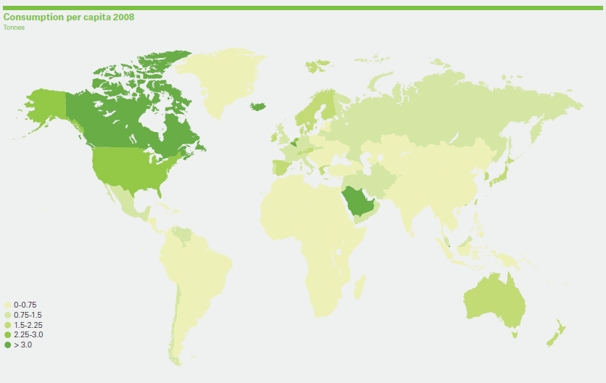
Oil consumption per capita
Notes:
Updated June 27 2010

Slide 15
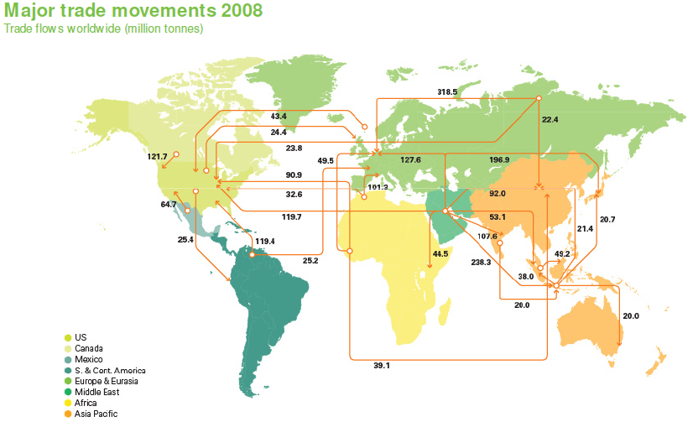
Major oil trade movements
Notes:
June 30 2010

Slide 16
Major oil trade movements
Notes:
June 30 2010

Slide 17
World Petroleum Demand
2002
2011
U.S.A
Europe
Far East
78 MM Bbl/d
93 MM Bbl/d
Latin America
Others

Slide 18
OPEC Surplus Production Capacity
1 September 2003 Position
Iraq Exports 0.9
Venezuelan Exports 1.3-1.7
Total: 2.66 Mb/d
All Non-OPEC capacity assumed to be utilised 100%.
Notes:
Opec produces about 28million BPD of oil and the biggest producer in the world is now ……….. Russia, not Saudi Arabia.
However the Saudis have the ability to set the marginal price since they are the swing producer. However a cushion of only 3mm BPD is small in the context of global oil demand of 75mm BPD – witness what Venezuela strikes did to oil markets.
Kuwaiti output includes Neutral Zone; Iraqi exports include UN exports of just over 1.7 and illicit exports of roughly 300,000 b/d.

Slide 19
Crude Oil Characteristics
Crude oils are classified by their density and sulfur content.
Less dense (or "lighter") crudes generally have a higher share of light hydrocarbons -- higher value products
The denser ("heavier") crude oils produce a greater share of lower-valued products with simple distillation and require additional processing to produce the desired range of products.
Some crude oils also have a higher sulfur content, an undesirable characteristic with respect to both processing and product quality.

Slide 20
Heavy or Dense?
Specific Gravity (SG) measures the weight of a compound relative to water.
SG = Weight of the Compound
Weight of water
API gravity = 141.5 -131.5
Specific Gravity

Slide 21

API Gravity
Water has an SG of 1 and an API gravity of 10 degrees
The higher the API gravity, the lighter the compound (which is the opposite of specific gravity)
API gravity > 10 means ?
API gravity < 10 means ?
Naphtha (50 API)
Asphalt (11 API)

Slide 22
Factors Affecting Crude Oil Cost
Amount of Sulfur
Sweet (Low Sulfur – 1.0% or less)
Sour (High Sulfur - 1.0% or greater)
Specific Gravity
Light Crude - API gravity of greater than 38
Heavy Crude - API gravity of less than 22
Intermediate Crude - API 22 to 38
Volatility (measured in RVP)
Toxicity (hydrogen sulfide content)
Acidity (how corrosive it is)

Slide 23
Sweet or Sour?
Sulfur content is the second most important determinant of a crude oil’s value.
Sweet crudes generally have < 1% Sulfur
Sour crudes generally have > 1% Sulfur
The higher the sulfur and the lower the API so the value of the crude decreases
High Value Crudes
WTI 40 API, 0.25% Sulfur
Brent 39 API, 0.3% Sulfur
Low Value Crudes
Maya 22 API, 3.4% Sulfur
Arab Medium 30 API, 2.5% Sulfur

Slide 24
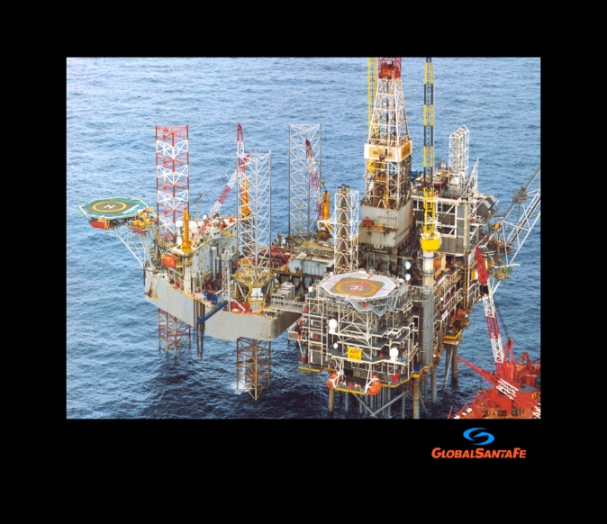
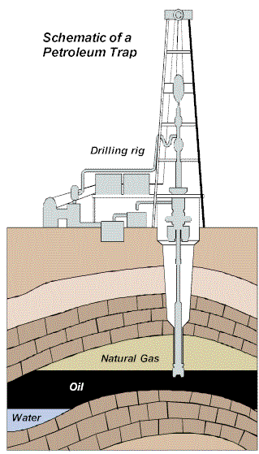
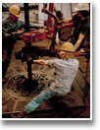
Drilling and Producing Oil and Natural Gas

Slide 25
Finding & Lifting Costs
$7.50
$7.59

Slide 26


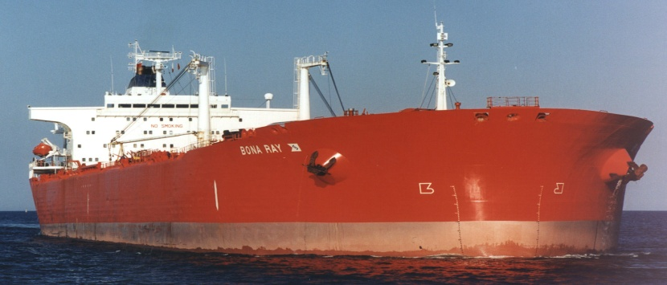
Shipping Petroleum by Water
Transports 2.0 MM Bbls with Draft of 90 Feet
VLCC
Transports 1.0 MM Bbls with draft of 45 Feet (largest vessel which can use Suez Canal)
Suezmax
Transports 0.5 MM Bbls with draft of 67 Feet
Aframax

Slide 27
Financial Crude Oil Markets
WTI and Brent crude oil contract are the most actively traded
Crude oil contract is 1,000 Barrels
Primary purpose is to hedge risk and speculate
Active OTC market as well as Exchange market
Market is very liquid for about 18 months
Hedging past two years done with major trading houses (Morgan Stanley, Goldman Sachs, etc.)

Slide 28
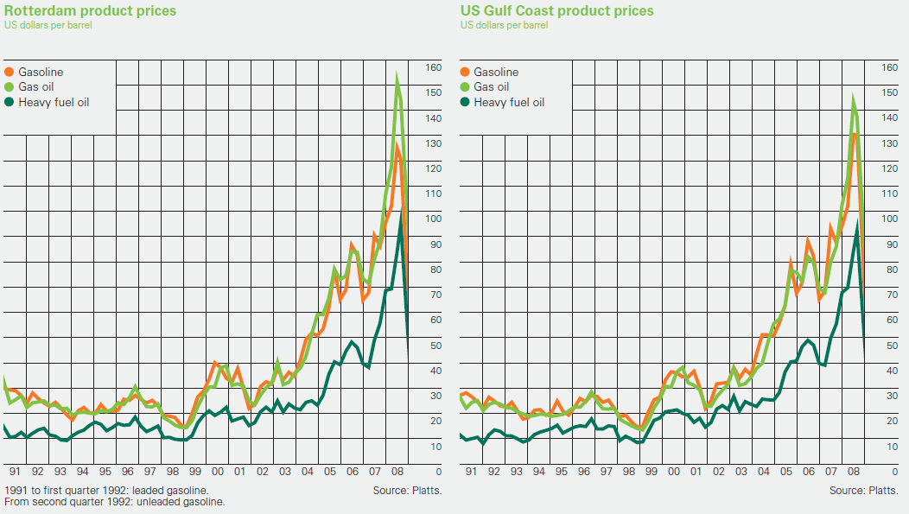
Rotterdam Oil Product Prices
Notes:
June 30 2010

Slide 29
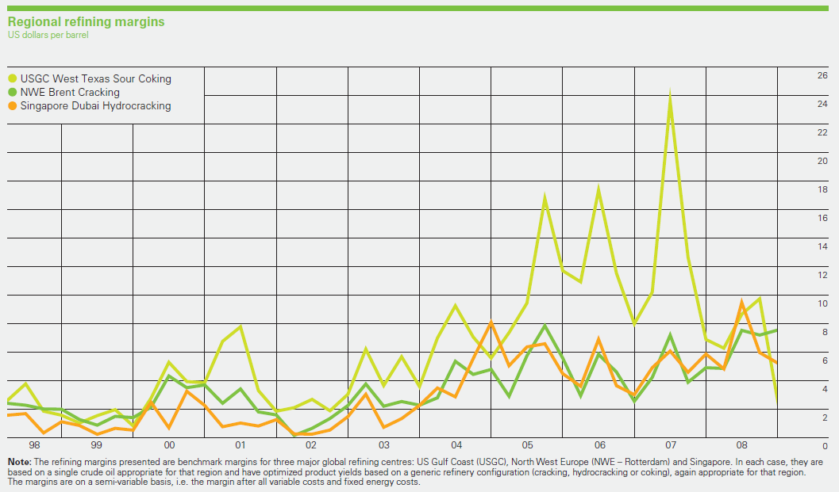
Regional oil refining margins
Notes:
June 30 2010

Slide 30
Light/Heavy Spread
Source: S&P’s DRI/Platts
Notes:
The light-heavy crude oil price difference can fluctuate quite a bit in the short term. However, this graph shows that, while there are some significant cyclical ups and downs, there is no sign of increasing differentials trendwise.
That is, as yet, there is no sign of a major shift to heavy crude oil advantage relative to history.
But will this continue in to the future?

Slide 31
Heavy Crude imports increase
Source: EIA
Notes:
The graph shows that the growth in imports has been more in the medium to heavy oils category. (This is a rough approximation of import quality based on country import data and estimating a country’s quality breakdown based on a sample from the import cargo data.)

Slide 32
U.S. Refinery Input Quality
Source: EIA
Notes:
Not surprisingly, with imports growing heavier and more sour, total refinery feedstocks have been moving to higher sulfur and lower gravity crude oils in general.

Slide 33
Increased ability to handle Sour crudes
Source: EIA – Capacity as of January Each Year
Notes:
The changes in refinery feedstocks toward poorer quality crude oils are reflected in in capacity changes.
Coking capacity, the main choice for bottoms processing, has grown the most on a percentage basis. It has increased 56% since 1987, followed by hydrocracking capacity at 37%, and FCC capacity, which increased 14%.
The distillation capacity on this chart reflects closures as well as refineries that have stayed in operation. In the mid 1990’s, product demand growth brought distillation capacity utilization into the mid 90 percent range, and net distillation capacity began to grow then as well as downstream capacity, reaching 8% over where it was in 1987.

Slide 34
Shipping by Land: U.S. Crude
Edmonton
Vancouver
Hardisty
Regina
Puget Sound
Montreal
Billings
Portland
St. Paul
Casper
Guernsey
Chicago
Sarnia
Salt Lake
City
Toledo
Wood
River
Patoka
Cushing
Existing
Proposed IPL Expansion
New AEC Express Line
Mobil Reversal to Wood River
Proposed Reversal of Line 9
Production Areas
Hubs
Midland
Houston
St. James

Slide 35
Refinery Cracks or Cracking Margins
A refinery crack is a simplistic formula for calculating theoretical future margin when refining a certain benchmark crude. For example:
3:2:1 = 3 barrels of oil equals 2 barrels of gasoline output and 1 barrel of heating oil (where 2 times the price per barrel of gasoline and 1 times the price of heating oil is added together and then subtracted from the cost of 3 barrels of crude)
2:1:1 = 2 barrels of oil equals 1 barrel of gasoline output and 1 barrel of heating oil (use formula similar to above)
1:1 = 1 barrel of crude equals 1 barrel of gasoline (or heating oil)

Slide 36
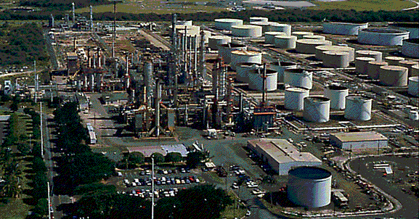
Oil refinery
Notes:
What does a refinery do? Separates, Converts and Modifies to produce higher value products.
Three Phases of Refining
Carbon number separation
Distillation
Split crude oil into fractions with certain boiling ranges
Carbon number reduction
Hydrocracking, Fluid Catalytic Cracking, Coking
Crack heavier crude oil fractions into lighter fractions through conversion processes (650 - 1000 deg. F).
Molecular Rearrangement
Reforming, Hydrotreating
Hydrotreat and reform light fractions to meet specs.
Blend away the resid that cannot be cracked (marine fuel oil)
The key take away --> Refineries make money by cracking conversion feed to lighter products and resid to conversion feed.
Refining economics are driven by conversion, not by separation.

Slide 37
Processing (High yield refinery)
100%
100%
LPG’s
3%
Crude Oil
Gasoline’s
59%
GPW
Jet Fuel
9%
Heating Oil
24%
Resid
5%
Notes:
In the refining section on Wednesday, you learned about GPW (Gross Product Worth). Based on a delivered crude oil price of $28.50, you could produce products worth $35.50. After costs of $2.50, your net contribution to fixed overheads is $4.50/bbl. Pretty darn good!
How do you protect some of that?
Ideally you’d:
estimate what your risk tolerance was
evaluate how much risk you want to keep
come up with a game plan to hedge the rest
Since the markets are not liquid in some commodities (e.g., LPGs or resid) it’s sometimes hard to sell those products today (January 1st) and find buyers ready to pay a fixed price.

Slide 38
Gross Product Worth (Sept 8 2003)
Sour crude in a high conversion refinery in USGC

Slide 39
Processing (High yield refinery)
Total costs = $2.50/bbl
100%
100%
LPG’s
3%
Crude Oil
Gasoline’s
59%
GPW
Jet Fuel
9%
Heating Oil
24%
Resid
5%
$28.50 Delivered
$35.50 F.O.B.
Net margin of $4.50/bbl
Notes:
In the refining section on Wednesday, you learned about GPW (Gross Product Worth). Based on a delivered crude oil price of $28.50, you could produce products worth $35.50. After costs of $2.50, your net contribution to fixed overheads is $4.50/bbl. Pretty darn good!
How do you protect some of that?
Ideally you’d:
estimate what your risk tolerance was
evaluate how much risk you want to keep
come up with a game plan to hedge the rest
Since the markets are not liquid in some commodities (e.g., LPGs or resid) it’s sometimes hard to sell those products today (January 1st) and find buyers ready to pay a fixed price.

Slide 40
Crude Oil Fractions
Boiling Pt.
Volume %
<160 ºF
8%
160–375 ºF
19 %
375-540 ºF
15 %
540-650 ºF
10 %
650-1000 ºF
28 %
1000 + ºF
20 %
Arab Medium Crude Oil
31 API 2.5 wt% S
Notes:
Conversion feed is 650 - 1000 deg F boiling range.
There are two big dollar lines to cross 650 degrees and 1000 degrees.
Once we have cracked a molecule above the 650 degree line, at worst it is diesel fuel. Refineries make money by cracking conversion feed (650-1000) to lighter products and resid (1000+) to conversion feed.
Minimize production of 1000 degree F material. Blend away the resid that cannot be cracked (marine fuel oil)
Refining economics are driven by conversion, not by separation.

Slide 41
Global Natural Gas
Notes:
Move on to discuss worldwide gas and gas flows.

Slide 42
Natural Gas (International)
Historically a byproduct of oil production
Recent move to utilize or monetize by resource rich nations
Localized markets - mostly power, not local distribution companies
LNG - Costly, demands large resource base and long term dedicated market to exploit
Gas to Liquids - Costly, technology not commercially proven
Some governments have attempted to produce higher value downstream products - methanol, ethanol, ammonia
Huge undeveloped potential
Notes:
Gas was traditionally a nuisance product – low in value, hard to capture, difficult to move. However as the price rose steadily due to a recognition of its unique features so did the incentive to capture it and take it to market.

Slide 43
World Natural Gas Consumption
85 TCF/yr (232 BCFD)
USA (27%)
All Other (21%)
A/P (10%)
EU (19%)
FSU (23%)
Notes:
Over 50% of the world’s natural gas consumption occurs in the US and former Soviet Union.
Over half of Asia/Pacific Demand is met through imported LNG
LNG due to lack of their own domestic gas supplies but need to have clean burning fuel….eg smokestacks of Japan and Korea and increasingly China.

Slide 44
World Natural Gas Reserves
5,300 TCF (62 years)
Middle East (34%)
FSU (39%)
All Other (24%)
(3%)
USA
167 TCF = 7.5 Years
Notes:
US RP down from 9 years in 1990. Our review of LNG will consider the viability and costs of this commodity as a major supply source to the US
4000 TCF or almost 80% of known reserves are “Stranded”. Consider LNG and GTL as a means to tap these resources

Slide 45
Reserves by National/Private Company
(TCF)
1 | Gazprom | 1,700 | 11 | Petronas | 81 | 21 | Oman | 29
2 | NIOC | 812 | 12 | Pertamina | 72 | 22 | India | 18
3 | Qatar Petroleum | 300 | 13 | Uzbekistan | 66 | 23 | TotalFinaElf | 17
4 | Saudi Aramco | 204 | 14 | Shell | 60 | 24 | Petrobras | 15
5 | Abu Dhabi | 196 | 15 | ExxonMobil | 57 | 25 | Brunei | 14
6 | PdVSA | 142 | 16 | Kuwait NOC | 52 | 26 | ENI | 13
7 | Sonatrach | 130 | 17 | China | 48 | 27 | PA Thailand | 12
8 | Nigeria NOC | 114 | 18 | Libya NOC | 46 | 28 | Repsol YPF | 12
9 | Iraq | 109 | 19 | BP | 37 | 29 | Statoil | 12
10 | Turkmenistan | 101 | 20 | Pemex | 30 | 30 | Texaco | 10
Notes:
Observations:
With the notable exception of Gazprom, gas reserves are not held in areas of high consumption. Gazprom has the highest reserves in the world of any organization.
Indonesia, Southern Australia, Alaska and the MidEast
Reserves are generally held by sovereigns or state owned oil companies

Slide 46
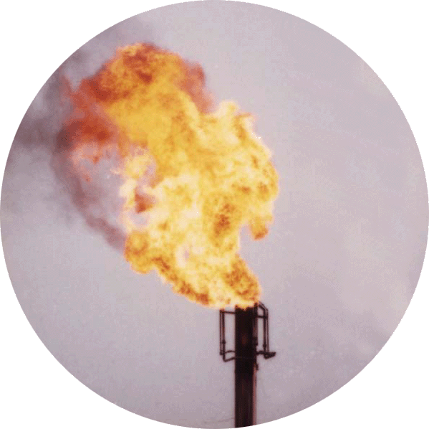
Gas Monetization Options
Problem:
80% of natural gas or
800+ billion BOE of natural gas too remote from market - currently flared or shut-in
Notes:
Stuck in places like offshore West Africa or offshore Peru.
Capital costs of building liquefaction and transportation are enormous.
What are the solutions?

Slide 47
US Energy Consumption
Notes:
Clean, relatively safe, traditionally cheap on a BTU basis, plentiful
Consumes half of US energy demand

Slide 48
World Natural Gas Consumption
85 TCF/yr (232 BCFD)
USA (27%)
All Other (21%)
A/P (10%)
EU (19%)
FSU (23%)
Notes:
Over 50% of the world’s natural gas consumption occurs in the US and former Soviet Union.
Over half of Asia/Pacific Demand is met through imported LNG
LNG due to lack of their own domestic gas supplies but need to have clean burning fuel….eg smokestacks of Japan and Korea and increasingly China.

Slide 49
World Natural Gas Reserves
5,300 TCF (62 years)
Middle East (34%)
FSU (39%)
All Other (24%)
(3%)
USA
167 TCF = 7.5 Years
Notes:
US RP down from 9 years in 1990. Our review of LNG will consider the viability and costs of this commodity as a major supply source to the US
4000 TCF or almost 80% of known reserves are “Stranded”. Consider LNG and GTL as a means to tap these resources

Slide 50
Reserves by National/Private Company
(TCF)
1 | Gazprom | 1,700 | 11 | Petronas | 81 | 21 | Oman | 29
2 | NIOC | 812 | 12 | Pertamina | 72 | 22 | India | 18
3 | Qatar Petroleum | 300 | 13 | Uzbekistan | 66 | 23 | TotalFinaElf | 17
4 | Saudi Aramco | 204 | 14 | Shell | 60 | 24 | Petrobras | 15
5 | Abu Dhabi | 196 | 15 | ExxonMobil | 57 | 25 | Brunei | 14
6 | PdVSA | 142 | 16 | Kuwait NOC | 52 | 26 | ENI | 13
7 | Sonatrach | 130 | 17 | China | 48 | 27 | PA Thailand | 12
8 | Nigeria NOC | 114 | 18 | Libya NOC | 46 | 28 | Repsol YPF | 12
9 | Iraq | 109 | 19 | BP | 37 | 29 | Statoil | 12
10 | Turkmenistan | 101 | 20 | Pemex | 30 | 30 | Texaco | 10
Notes:
Observations:
With the notable exception of Gazprom, gas reserves are not held in areas of high consumption. Gazprom has the highest reserves in the world of any organization.
Indonesia, Southern Australia, Alaska and the MidEast
Reserves are generally held by sovereigns or state owned oil companies

Slide 51
Gas Monetization Options
Problem:
80% of natural gas or
800+ billion BOE of natural gas too remote from market - currently flared or shut-in
Notes:
Stuck in places like offshore West Africa or offshore Peru.
Capital costs of building liquefaction and transportation are enormous.
What are the solutions?

Slide 52
US Energy Consumption
Notes:
Clean, relatively safe, traditionally cheap on a BTU basis, plentiful
Consumes half of US energy demand

Slide 53
Why Gas?
Key Characteristics
Odorless, Colorless
Easily transportable (if infrastructure exists)
Efficient heat/power source
Impurities relatively easily removed at the source
Historically gas was viewed as a waste product consequential to oil production - still a problem in most of the world.
Significance
Cleanest fuel available
98% of new power generation will be gas fired
Relative ease of permitting
Environmental compliance
Greater efficiency in converting fuel to power
Low capital cost and construction time
Notes:
Clean, relatively safe, traditionally cheap on a BTU basis, plentiful
Consumes half of US energy demand

Slide 54
Gas Business Structure
Exploration & Production
Exxon/Mobil Devon Energy
High Risk - High Reward
High Margins
Price Volatility
Heavy/Constant Capital Investment
Low Operating Cost
Transmission
Dominion El Paso Duke
Low Margin
High Turnover
Regulated Environment
Installed, Old Infrastructure
Limited Growth
Distribution/Trading - Deregulated
Koch DENA
Variable Margins, Potentially High
Market Structures Developing
Unregulated Environment
Price Volatility Feeds Growth
Unlimited Growth potential
Distribution - Regulated
CenterPoint Duke
Low Margin
High Turnover
Highly Regulated Environment
Installed, old infrastructure
Limited Growth
Notes:
4 types of businesses touch natural gas:
Upstream
Midstream
Wholesale marketing and optimization
Local distribution

Slide 55
Producing Basins And Regional Natural Gas Flows
Source: EIA
Notes:
Natural gas resources are distributed between a number of major geologic basins. Most U.S. natural gas is produced in the onshore and offshore regions of the Gulf coast. According to 2001 data, 60 percent of gas produced in the United States flows from the onshore and offshore areas of the Gulf of Mexico. Another 23 percent was produced in New Mexico, Oklahoma, and Wyoming.
Many major consuming markets (e.g., the Northeast, Midwest, California, and Florida) are located at significant distances away from the producing regions, so the system depends on the pipeline network.
The interstate pipeline network consists of almost 300,000 miles of pipe.
(The map shows major geologic basins and transportation corridors. The relative size of transportation flows is reflected in the size of the arrows. The basins, on the other hand, are represented in terms of the area in which the basins lie. The largest basins on the map are not necessarily the most prolific.)

Slide 56
Natural Gas Pipeline Systems 2002 U.S. Interstate and Selected Intrastate
Source: Energy Information Administration, Office of Oil & Gas
, EIAGIS-NG Geographic Information System
Notes:
Over 300,000 miles of pipelines – the only major new interstate pipeline to be built is the new Gulfstream P/L from Texas to Florida in which Duke is a partner I believe. Huge installed infrastructure
Producing regions not same as consuming regions
Transmission 1940’s vintage
Barriers to expansion
Investment
Environmental

Slide 57
U. S. Demand Growth
Electricity Generation
Industrial
Residential
Commercial
Other
Source: EIA
Notes:
This chart shows the recent trend and forecast usage of gas in the US.
Power generation growth will be the biggest user, followed by industry then residential and light industry/commerce. Note that all the new gas fired power plants will take up 50% of the expected growth in gas demand.

Slide 58
Access Restrictions
U.S. Lower 48 Access Restrictions
21
TCF
31
TCF
137 TCF
Access restrictions encumber most prospective acreage in lower 48.
Restrictions in Alaska and Canada are worse.
Restrictions mostly due to government regulations
24
TCF
Notes:
National forests, parks and environmental rules prohibit drilling in new areas of high potential. The shaded areas represent where gas is probably to be found but is not available for drilling at this time.

Slide 59
Seasonalized Consumption & Storage
Working Gas in Storage
1998
1999
2000
Consumption - All Uses
Source: EIA
Notes:
Another trait of gas is its highly seasonalized demand pattern in the US.
An extra 1tcf of demand in winter than in summer
Stored gas moderates the changes however with increased demand for gas we could be reaching a crunch point in 2005 when the capacity for NG finally is matched by peak day demand. This implies that we need more infrastructure.

Slide 60
Gas Rigs Tend To Follow Spot Prices With A Lag
Source: Natural Gas Intelligence Weekly Gas Price Index, Baker-Hughes Weekly US Rig Report.
Notes:
Natural gas rigs exhibit a loose correlation with the Henry Hub spot price, however, with a lag.
As an example of the response lag, the peak of 1,068 gas rigs was attained in mid July 2001, although spot prices had peaked in January and subsequently declined. Similarly, rig activity began to recover in 2002 only after the spot price has started to rise.
Henry Hub spot prices seem to have peaked in February 2003 at an average of $7.64 per MMBtu, with a one-day spike of $18.85. The subsequent decline has not discouraged the expanding gas rig count to date. As of June 13, gas rigs running were 910, which is about 30 percent above the rig count at the start of the year, and more than 50 percent above the bottom level hit in April 2002.

Slide 61
Natural Gas Stocks are Recovering Strongly from Winter Lows
Notes:
This figure shows historical data for natural gas storage stocks for the U.S. and 3 regions: Producing, Consuming East, Consuming West.
Storage stocks began this past winter in the upper end of the 5-year-average range, indicated on the figure—total stocks: 3,116 Bcf.
Natural gas in storage hit new all-time lows on April 13, 2003, working gas volumes were 623 Bcf—well below the previous record low of 697 reported for April 12, 1996.
Positive net injections occurred during the final 2 weeks of the heating season. However, operators reported net withdrawals for the first 2 weeks of the refill season.
As of June 6, stocks relative to the 5-year average in the East and Producing regions were at roughly 27 and 33 percent below average.
Stocks in the West are within the 5-year operating range, although about 2 percent below average.
Overall, stocks are about 25 percent below the 5-year average. This has caused some concern about market conditions during this summer and then into the winter. The need for refill volumes is addressed in the following slides.

Slide 62
Natural Gas Storage
History
Projections
Billion Cubic Feet
Source: EIA
Notes:
As of August 2003 we are about 20% below normal historic stock build in the US.

Slide 63
Natural Gas Stocks are Recovering Strongly from Winter Lows
Notes:
This figure shows historical data for natural gas storage stocks for the U.S. and 3 regions: Producing, Consuming East, Consuming West.
Storage stocks began this past winter in the upper end of the 5-year-average range, indicated on the figure—total stocks: 3,116 Bcf.
Natural gas in storage hit new all-time lows on April 13, 2003, working gas volumes were 623 Bcf—well below the previous record low of 697 reported for April 12, 1996.
Positive net injections occurred during the final 2 weeks of the heating season. However, operators reported net withdrawals for the first 2 weeks of the refill season.
As of June 6, stocks relative to the 5-year average in the East and Producing regions were at roughly 27 and 33 percent below average.
Stocks in the West are within the 5-year operating range, although about 2 percent below average.
Overall, stocks are about 25 percent below the 5-year average. This has caused some concern about market conditions during this summer and then into the winter. The need for refill volumes is addressed in the following slides.

Slide 64
Natural Gas Storage
History
Projections
Billion Cubic Feet
Source: EIA
Notes:
As of August 2003 we are about 20% below normal historic stock build in the US.

Slide 65
Potential Solution?
LNG
Notes:
LNG is one solution and one that is being heavily promoted here in the US.

Slide 66
Key LNG Markets
LNG remains a regional business
UK
Italy
USA
USA
Spain
Korea
Adgas
Japan
China
Trinidad
India
Europe to India
Asia Pacific
Atlantic
Vico
Tangguh
NWS
Notes:
LNG has been around a long time with extensive use in Japan, Korea, Taiwan. Asia Pacific: This market is characterized by longterm contracts which is what the oil companies needed to take the risk of investing so much money.
Also close to market, lack of substitutes
LNG remains a regional business
US: deep and liquid market -- gaining access to regas capacity ensures access to market
Europe: partial liberalisation -- regas capacity and customers generally difficult to secure
Asia-Pacific: customers prefer long term contracts -- key is securing commitments
European use has intensified in recent years with the development of fields in N Africa.
USA – developed four major terminals for import but their cost was so high that they had to go bankrupt before they became economical to use! Also, cheap Canadian gas undermined the viability of LNG. However that is changing with higher gas prices in the US.
Merchant Trader Model
Early Market access
Portfolio opportunities
Linear business model
High Inertia environment
Gas monetization priority

Slide 67
LNG Industry Dynamics Continue to Drive Growth
7% CAGR
mtpa
U.S.
Europe
10% CAGR
Other
Taiwan
7% CAGR
5% CAGR
Korea
Japan
Early LNG growth
Rise of Asian LNG
Plentiful Gas Reserves
Source: BP
Notes:
Growth of LNG was really not until the 1980’s – green bar is Japan, lighter green is Korea, then bright green Taiwan, Europe in yellow and blue is the US.
US is expected to become a significant player in the second half of this decade.
Cheaper costs of producing and transporting LNG coupled with higher prices has made it more attractive to end use markets.
Phase 1: Asia lacks Proximal supply, New M.E Low Cost Supply, New Atlantic Low Cost Supply, US proximal supply declines
Phase 2: New Asian customers, CCGT drives gas demand, US access constraints & low prices, Eventually LNG gains greater market share of US supply gap
Phase 3: Gas demand growth continues ,Costs allow new smaller markets to be reached

Slide 68
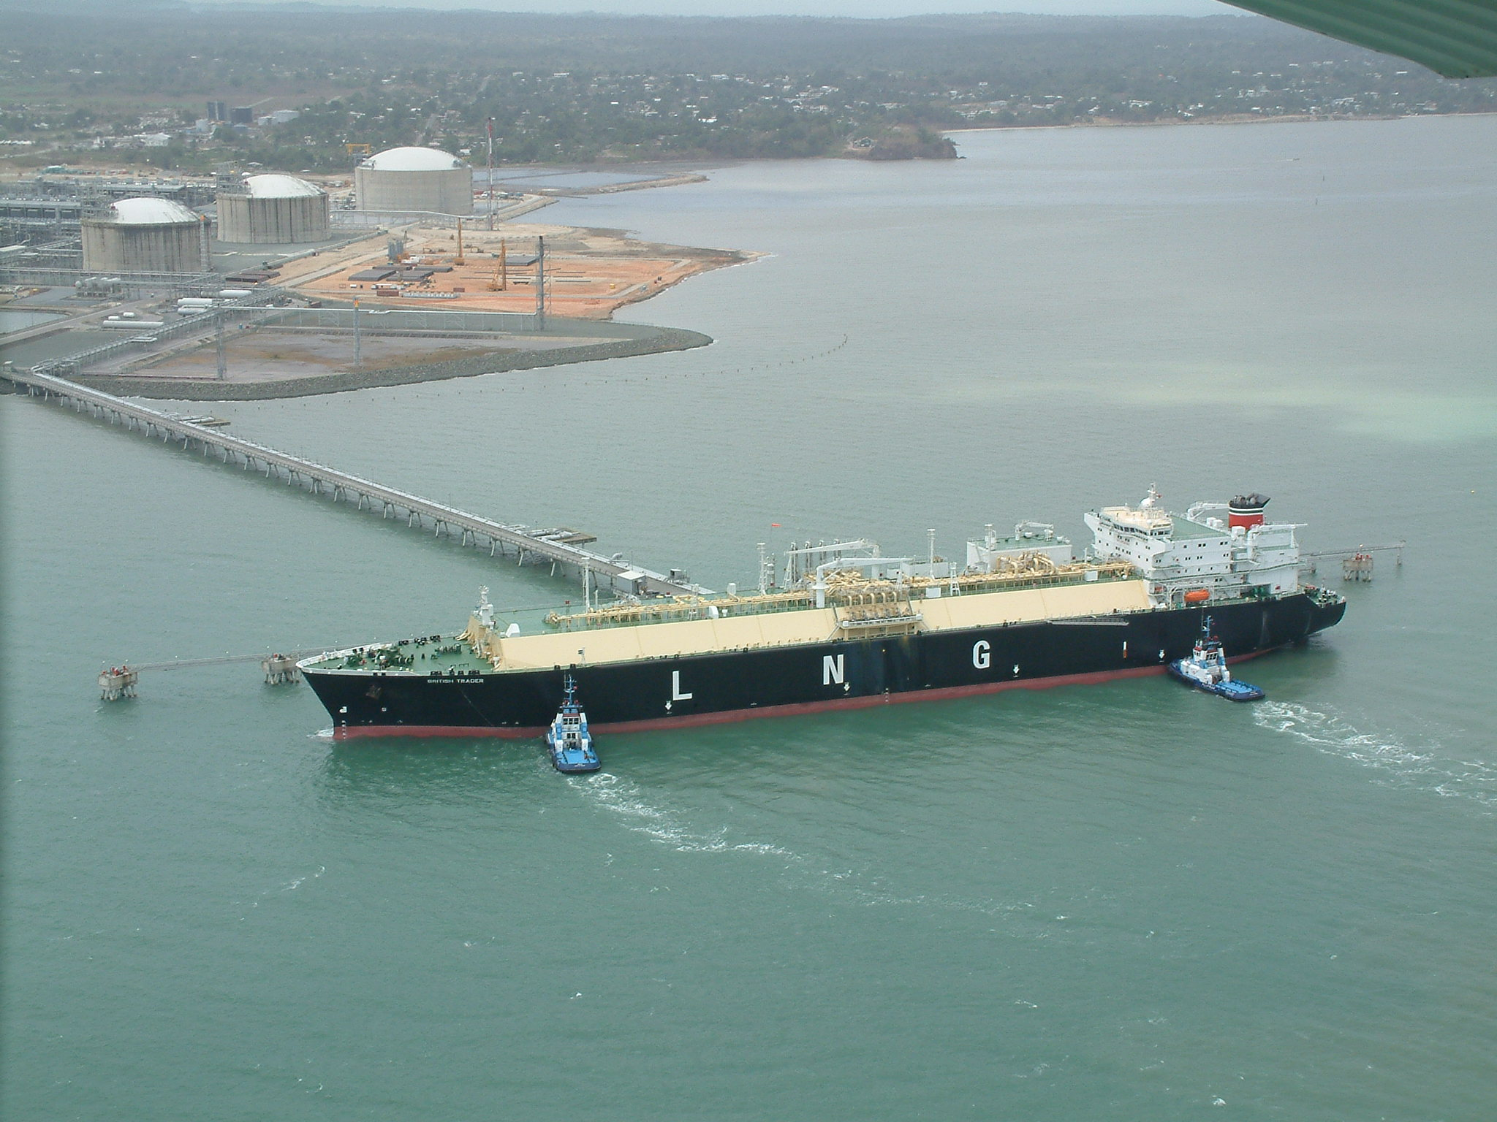
LNG Vessel in Trinidad
Notes:
Picture of a vessel which used to cost close to a billion dollars and are now more like 150-200 million dollars.
A lot of concern about the explosivity of LNG – a lot of regulatory hurdles to clear before a new facility is allowed.
Hand out Ferc press release on a new terminal in US

Slide 69










Trinidad – an emerging supply point for the Atlantic Basin
Diversion & Back Fill Opportunity
Boston
Spain
Cove Point
Elba Island
Lake Charles
Train 1 40% Spain 60% US & Other
Trinidad
Trains 2 & 3 40% Spain 60% US & Other
Notes:
Amoco in Trinidad is a huge producer of LNG with most of the product going to Spain. Arbitrage opportunities allowed this LNG to be sold into America and buying cheaper LNG from the Mideast to supply Spain resulting in a $0.3mm / year savings for Amoco and the Spanish customer.
This offered the potential to divert long term volumes destined for Spain to more attractive markets in the US. For example, Amoco expects to be supplying Trinidad volumes to Cove Point and the Dominican Republic next year. The differential cost of supply is $0.3/mmBtu, which is a substantial potential saving for Amoco and its partners on an annual basis. This has allowed both supplier and customer to optimize and share the benefits arising from market arbitrage and shipping costs.
The risk management component of the arrangement gave the customer an opportunity to balance supply/demand in its principal domestic gas market in Spain. What each of these commercial components had in common was flexibility – both for the customer and for the supplier.

Slide 70
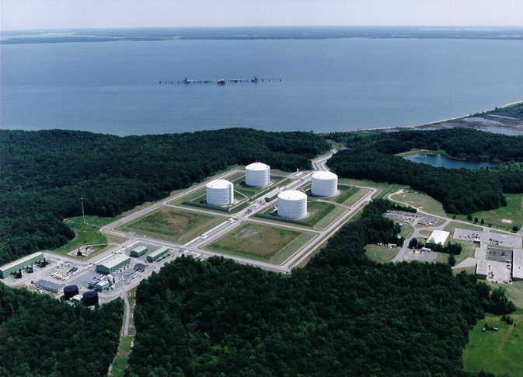
Cove Point Terminal
Notes:
Here is a photo of Cove Point terminal now owned by Tractebel (?) and on long term lease.

Slide 71
Near-Term Natural Gas Market Issues
Supply: Will supply increase enough to satisfy growth in consumption? Will Boom and bust cycles discourage investment?
Weather: The possibility of a hot summer or cold winter would put upward demand pressure on gas markets.
Storage: Will refill be adequate for next winter’s demand?
Consumption: Will forecasted growth in natural gas consumption be realized? How will consumption be affected by price volatility, fuel competition and service requirements
of electric generators?
Pipelines: Will necessary capital investments be made to expand delivery capability?

